Slide 1

Lecture 8 Cyber Security Essentials 20CYS114
-Saurabh Shrivastava
TIFAC Core in Cyber Security
Amrita Vishwa Vidyapeetham

Slide 2
Protocols
Layer 3 Protocols
ARP
IP
ICMP
Layer 4 Protocols
TCP
UDP

Slide 3
ICMP (Internet Control Message protocol)
It is a connectionless protocol, meaning a device does not need to open a connection with the target device before sending a message.
The primary purpose of ICMP is for error reporting. If a packet of data is too large for a router, the router will drop the packet and send an ICMP message back to the original source for the data.
A secondary use of ICMP protocol is to perform network diagnostics; the commonly used terminal utilities traceroute and ping both operate using ICMP.

Slide 4
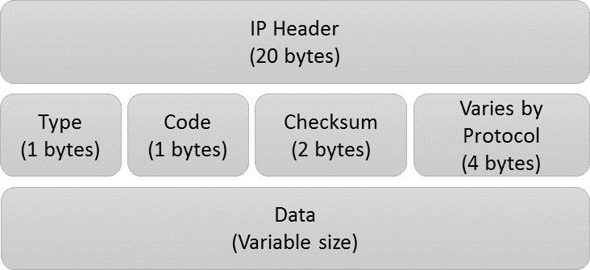
ICMP Packet Structure

Slide 5
Type Attribute
The first 8 bits are the message types. Some common message types include the following:
Type 0 -- Echo reply
Type 3 -- Destination unreachable
Type 8 -- Echo
Type 5 – Redirect
For example, a Type 8 Echo is a query a host sends to see if a potential destination system is available. Upon receiving an Echo message, the receiving device might send back an Echo Reply (Type 0), indicating it is available.

Slide 6
Checksum
The last 16 bits provide a message integrity check. The checksum shows the number of bits in the entire message and enables the ICMP tool to check for consistency with the ICMP message header to make sure the full range of data was delivered.

Slide 7
Error Detecting Codes
Whenever a message is transmitted, it may get scrambled by noise or data may get corrupted. To avoid this, we use error-detecting codes which are additional data added to a given digital message to help us detect if any error has occurred during transmission of the message.
Some popular techniques for error detection are: 1. Simple Parity check 2. Two-dimensional Parity check 3. Checksum 4. Cyclic redundancy check

Slide 8
Simple parity Check
Also called Even parity Check
1 is added to the block if it contains odd number of 1’s, and
0 is added if it contains even number of 1’s
It can detect only odd bit error
It cannot correct error

Slide 9
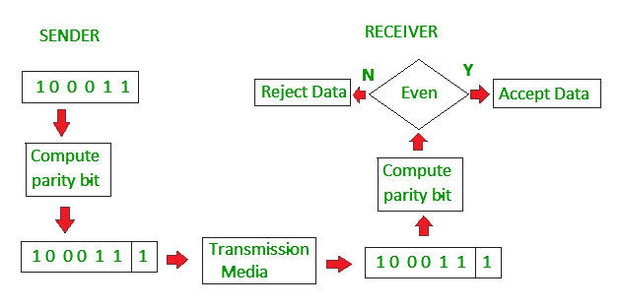
Simple parity Check

Slide 10
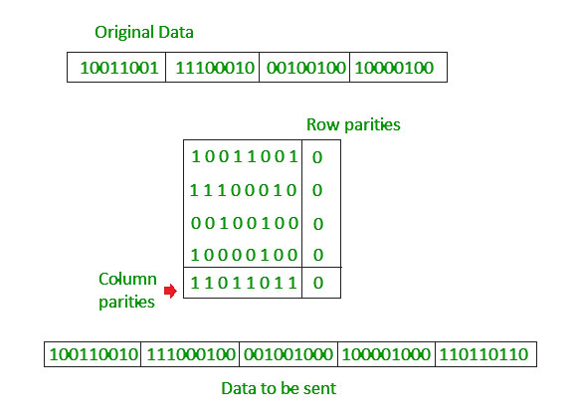
Two-Dimensional Parity Check

Slide 11
Checksum
In checksum error detection scheme, the data is divided into k segments each of m bits.
In the sender’s end the segments are added using 1’s complement arithmetic to get the sum. The sum is complemented to get the checksum.
The checksum segment is sent along with the data segments.
At the receiver’s end, all received segments are added using 1’s complement arithmetic to get the sum. The sum is complemented.
If the result is zero, the received data is accepted; otherwise discarded.

Slide 12
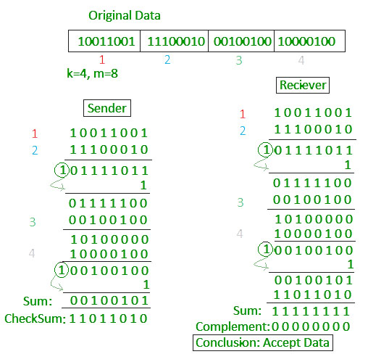
Checksum

Slide 13
Cyclic redundancy Check (CRC)
Unlike checksum scheme, which is based on addition, CRC is based on binary division.
In CRC, a sequence of redundant bits, called cyclic redundancy check bits, are appended to the end of data unit so that the resulting data unit becomes exactly divisible by a second, predetermined binary number.
At the destination, the incoming data unit is divided by the same number. If at this step there is no remainder, the data unit is assumed to be correct and is therefore accepted.
A remainder indicates that the data unit has been damaged in transit and therefore must be rejected.

Slide 14
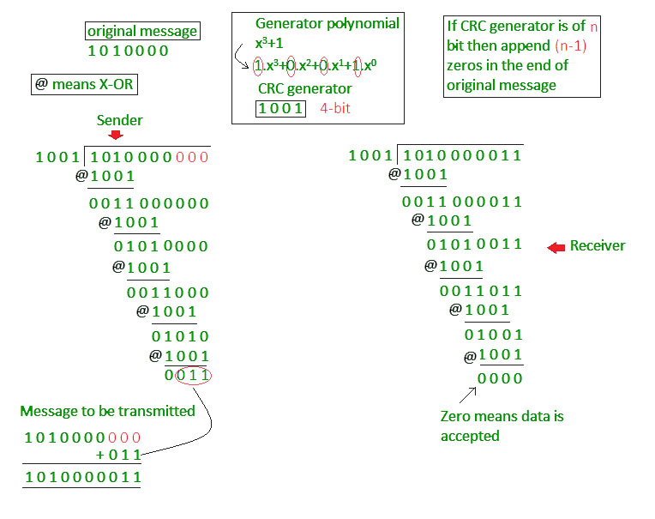
Cyclic redundancy Check (CRC)

Slide 15
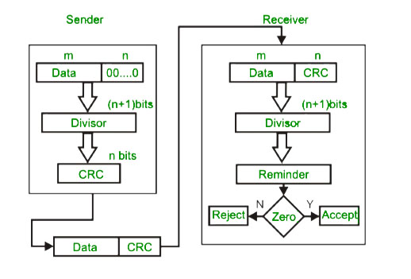
Cyclic redundancy Check (CRC)

Slide 16
Application layer Protocol
TCP
UDP
TCP is a connection-oriented protocol.
TCP is reliable as it guarantees the delivery of data to the destination router.
TCP provides extensive error checking mechanisms.
UDP supports Broadcasting.
The delivery of data to the destination cannot be guaranteed in UDP.
UDP has only the basic error checking mechanism using checksums.

Slide 17
Application layer Protocol
TCP
UDP
Sequencing of data is a feature of Transmission Control Protocol (TCP).
Retransmission of lost packets is possible in TCP.
TCP is comparatively slower than UDP.
There is no sequencing of data in UDP.
There is no retransmission of lost packets in the UDP.
UDP is faster, simpler, and more efficient than TCP.

Slide 18
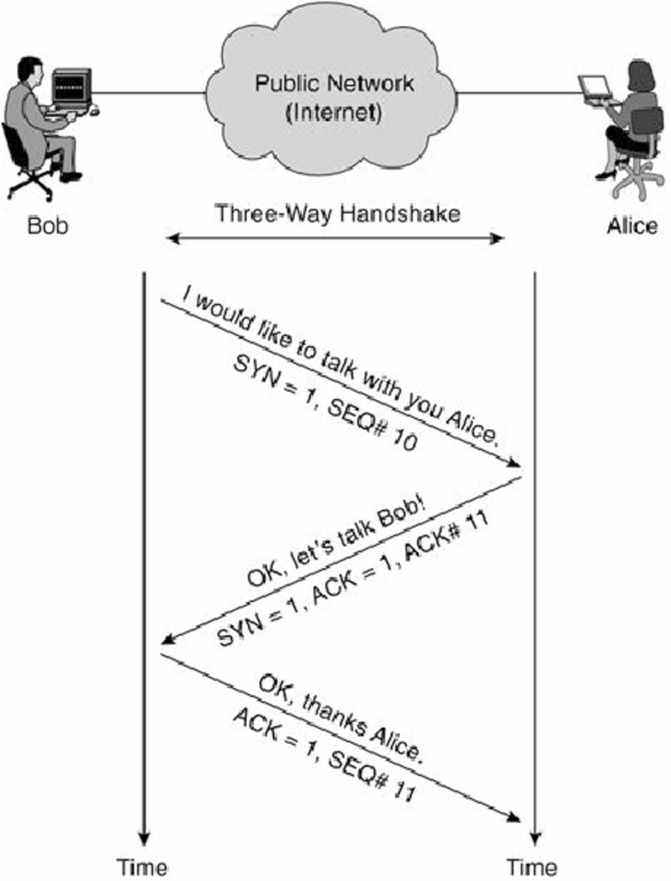
TCP Handshake

Slide 19
References
https://searchnetworking.techtarget.com/definition/ICMP
https://www.cloudflare.com/en-in/learning/ddos/glossary/internet-control-message-protocol-icmp/
https://www.geeksforgeeks.org/error-detection-in-computer-networks/
https://www.geeksforgeeks.org/differences-between-tcp-and-udp/

